Slide 1
IEEE 802 EC Privacy Recommendation SG Closing Report 802 Plenary Meeting March 9-13, 2015
Juan Carlos Zuniga, InterDigital Labs
(EC SG Chair)

Slide 2
March 2015 F2F Meeting
Venue
Estrel Hotel and Conference Center, Berlin, Germany
2 Sessions – ECC 4 meeting room, Conference Center, 2nd level
Tuesday, March 10th, 19:30 – 21:30 (EVE)
Thursday, March 12th, 08:00 – 10:00 (AM1)

Slide 3
IEEE 802 Privacy Recommendation PAR/CSD
PAR/CSD pre-circulated with 802 EC
PAR/CSD Presentation
https://mentor.ieee.org/privecsg/dcn/15/privecsg-15-0004-02-0000-privacy-recommendation-par-csd-proposal.pptx
PAR Text
https://mentor.ieee.org/privecsg/dcn/15/privecsg-15-0006-00-ecsg-privacy-recommendation-par-proposal.pdf

Slide 4
IEEE 802 Privacy Recommendation PAR/CSD
Received comments
https://mentor.ieee.org/privecsg/dcn/15/privecsg-15-0010-00-ecsg-par-csd-comments-received.pptx
Response to PAR CSD comments
https://mentor.ieee.org/privecsg/dcn/15/privecsg-15-0013-01-0000-response-to-par-csd-comments.pptx

Slide 5
IEEE Privacy EC SG Closing Report
PAR submission
Withdrawn from 802 EC closing agenda – some comments require further consideration by the group
Planning to refine text, especially with respect to intended audience for the recommended practices document
Will continue discussions on mailing list
Study Group extension
Planning to request extension for one more cycle

Slide 6
Technical Presentations
Max Riegel (Nokia Networks)
Initial thoughts about privacy aspects on P802.1CF specification
https://mentor.ieee.org/omniran/dcn/15/omniran-15-0015-00-CF00-privacy-engineered-access-network.pptx
Antonio de la Oliva (UC3M)
MAC address randomization experiment being run on IEEE 802 network during Berlin plenary meeting:
https://mentor.ieee.org/privecsg/dcn/15/privecsg-15-0007-01-0000-wifi-privacy-experiement-at-802-berlin-plenary.pptx

Slide 7
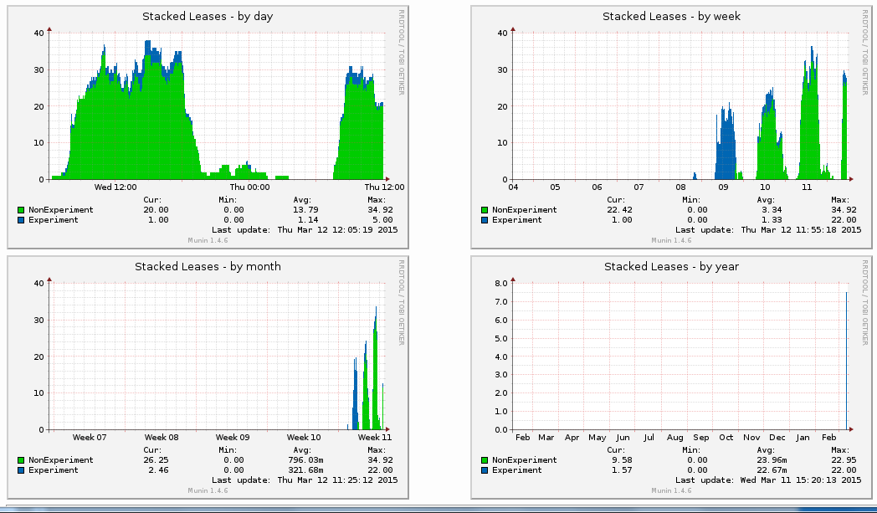
MAC Randomization Trial
MAC address randomization experiment run on IEEE 802 wireless network during Berlin plenary meeting
[Strong support from Verilan and Warren Kumari (Google)]
More info available at the trial Wiki page: http://goo.gl/eFUM9h

Slide 8
Proposed Next Steps
Refine PAR/CSD on recommended privacy practices for IEEE 802 protocols
Continue call for proposals to discuss technical topics
Threat Model for Privacy at Link Layer
Privacy Issues at Link Layer
Proposals regarding functionalities in IEEE 802 protocols to improve Privacy
Proposals regarding measuring levels of Privacy on Internet protocols
Implications of MAC address changes
Other…

Slide 9
Future Plans
Upcoming meetings (if SG is renewed)
Teleconferences
15 April 2015, (10:00 AM ET)
3 June 2015, (10:00 AM ET)
PAR/CSD submission
1 July 2015, (10:00 AM ET)
13-17 July, 2015, IEEE 802 Plenary meeting in Waikoloa, HI, USA

